Slide 1
Linear and Logistic Regression
Amos Azaria

Slide 2





Estimating Galaxy-Phone Cost by Name

Slide 3
Formalizing Linear Regression
y = wx + b
What would we do if we had only 2 training examples?
Our prediction will be h(x) = wx + b
Y={y₁,y₂,y₃…y_{m}}, X={x₁,x₂,x₃,…x_{m}}
Loss function:
Or:
Find w, b that will minimize J(w,b)
We could solve 2 equations with 2 parameters

Slide 4
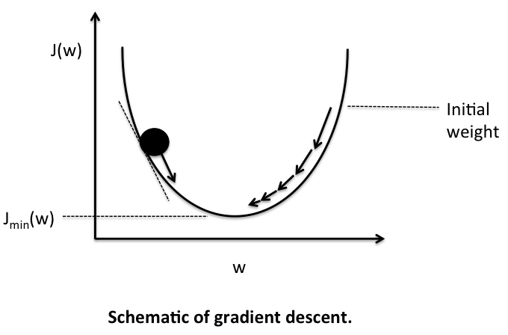
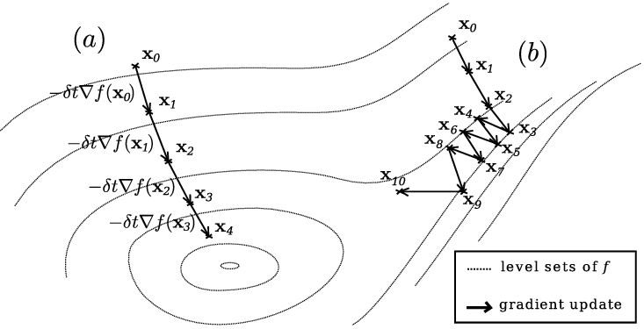
Gradient Descent
Note:
the function we are trying to minimize (J(w,b) has multiple parameters.
It is dificult to find values that zero the derivative.

Slide 5
What is the gradient (∇)?
A vector which represents the derivation of a function, which has multiple parameters.
Each entry is the function's derivative with respect to one of the parameters.

Slide 6
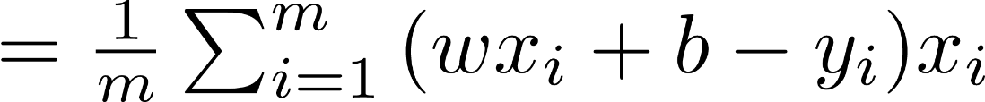
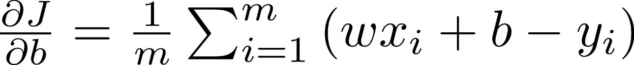
The Gradient for Linear Regression
Our loss function:

Slide 7
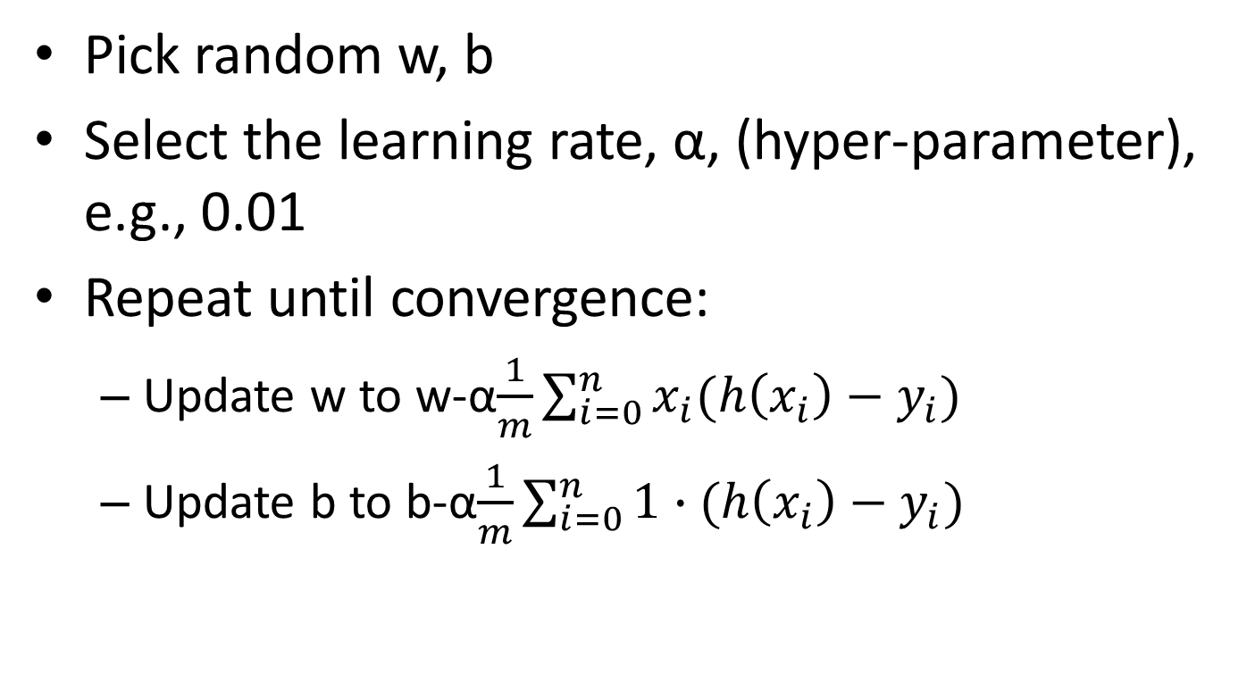
Gradient Descent in Linear Regression
Pick random w, b
Select the learning rate, α, (hyper-parameter), e.g., 0.01
Repeat until convergence:
Update w to w-α$\frac{1}{m}\sum_{i=0}^{n}{x_{i}(h\left(x_{i}\right)−y_{i})}$
Update b to b-α$\frac{1}{m}\sum_{i=0}^{n}{\text{1}∙(h\left(x_{i}\right)−y_{i})}$

Slide 8
Linear Regression with SGD in Python (Using the Galaxy Data-set)
import numpy as np
galaxy_data = np.array([[2,70],[3,110],[4,165],[6,390],[7,550]])
w = 0
b = 0
alpha = 0.01
for iteration in range(10000):
deriv_b = np.mean(1*((w*galaxy_data[:,0]+b)-galaxy_data[:,1]))
deriv_w = np.mean(galaxy_data[:,0]*((w*galaxy_data[:,0]+b)-galaxy_data[:,1]))
b -= alpha*deriv_b
w -= alpha*deriv_w
if iteration % 200 == 0 :
print("it:%d, grad_w:%.3f, grad_b:%.3f, w:%.3f, b:%.3f" %(iteration, deriv_w, deriv_b, w, b))
print("Estimated price for Galaxy S5: ", w*5 + b)
Notes:
Note that we are multiplying vectors!

Slide 9
Result:
it:0, grad_w:-1464.000, grad_b:-257.000, w:14.640, b:2.570
it:200, grad_w:-3.825, grad_b:19.693, w:70.598, b:-33.968
it:400, grad_w:-2.859, grad_b:14.720, w:77.230, b:-68.115
it:600, grad_w:-2.137, grad_b:11.003, w:82.188, b:-93.639
it:800, grad_w:-1.597, grad_b:8.224, w:85.893, b:-112.717
it:1000, grad_w:-1.194, grad_b:6.147, w:88.663, b:-126.977
it:1400, grad_w:-0.667, grad_b:3.434, w:92.280, b:-145.604
it:1800, grad_w:-0.373, grad_b:1.919, w:94.301, b:-156.010
it:2600, grad_w:-0.116, grad_b:0.599, w:96.062, b:-165.073
it:3600, grad_w:-0.027, grad_b:0.140, w:96.674, b:-168.226
it:4400, grad_w:-0.008, grad_b:0.044, w:96.802, b:-168.886
it:5400, grad_w:-0.002, grad_b:0.010, w:96.847, b:-169.116
it:6200, grad_w:-0.001, grad_b:0.003, w:96.856, b:-169.164
it:7000, grad_w:-0.000, grad_b:0.001, w:96.859, b:-169.179
it:7800, grad_w:-0.000, grad_b:0.000, w:96.860, b:-169.184
it:9800, grad_w:-0.000, grad_b:0.000, w:96.860, b:-169.186
Estimated price for Galaxy S5: 315.116281573
What would happen with alpha=0.5?
Actual price was: $250
Estimated price for Galaxy S1 is: -72.22 ☹
Notes:
With alpha=0.5, it would jump from side to side and would not converge.

Slide 10
Adding Features
Screen size
Number of cores
Core speed
Memory size
…

Slide 11
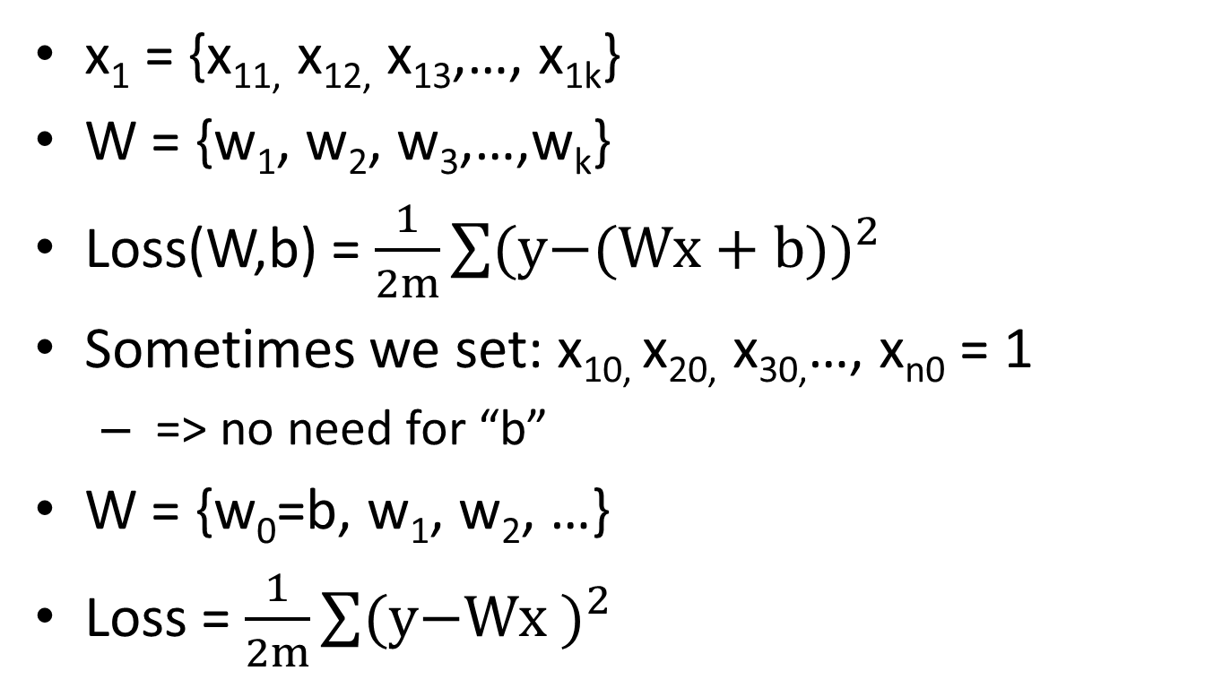
Adding Features (cont.)
x₁ = {x_{11,} x_{12,} x₁₃,…, x_{1k}}
W = {w₁, w₂, w₃,…,w_{k}}
Loss(W,b) = $\frac{1}{2m}\sum{{\text{(}\text{y}\text{−(}\text{Wx}\text{ + }\text{b}\text{))}}^{2}}$
Sometimes we set: x_{10,} x_{20,} x_{30,}…, x_{n0} = 1
=> no need for “b”
W = {w₀=b, w₁, w₂, …}
Loss = $\frac{1}{2m}\sum{{\text{(}\text{y}\text{−}\text{Wx}\text{ )}}^{2}}$

Slide 12
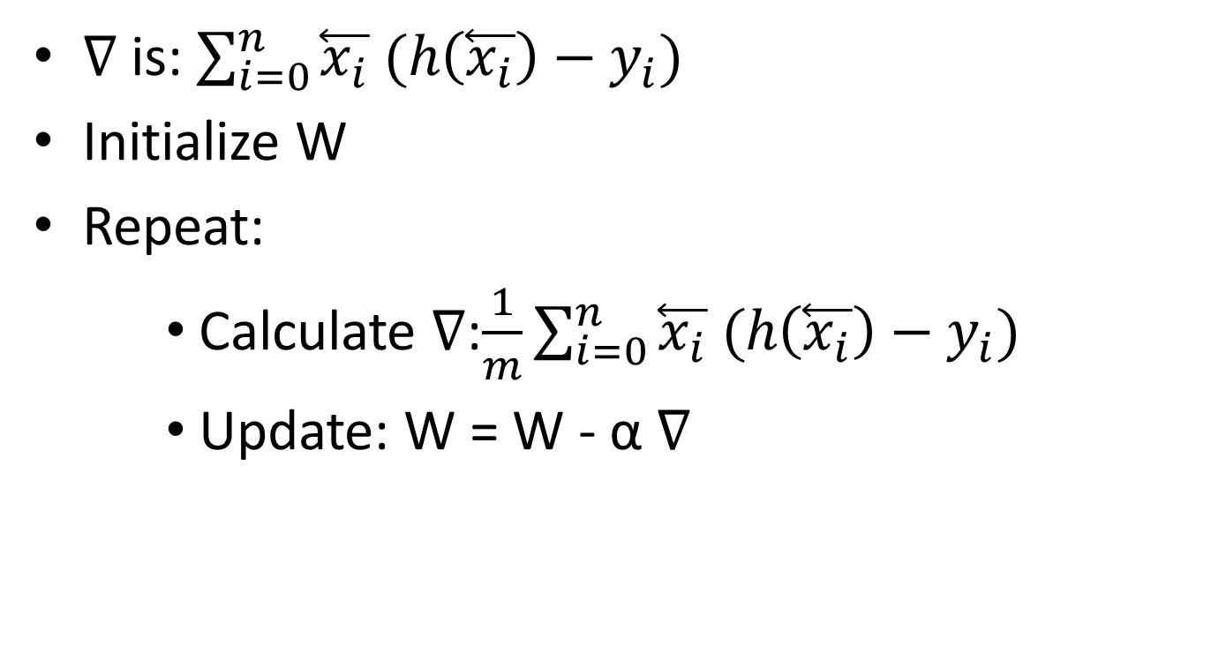
Gradient Descent with Multiple Features (is actually the same…)
∇ is: $\sum_{i=0}^{n}{\overset{⃖}{x_{i}} (h\left(\overset{⃖}{x_{i}}\right)−y_{i})}$
Initialize W
Repeat:
Calculate ∇:$\frac{1}{m}\sum_{i=0}^{n}{\overset{⃖}{x_{i}} (h\left(\overset{⃖}{x_{i}}\right)−y_{i})}$
Update: W = W - α ∇

Slide 13
Adding quadratic feature
We can add a feature which is simply a square of the first feature.
We will end up with 2 weights and one bias:
w₁ x + w₂ x² + b
This way, instead of fitting a linear line, we are actually fitting a quadratic function (parabola).

Slide 14
Quadratic Feature
import numpy as np data_x = np.array([[2,4],[3,9],[4,16],[6,36],[7,49]]) data_y = np.array([70,110,165,390,550]) w1 = 0 w2 = 0 b = 0 alpha = 0.001 for iteration in range(1000000): deriv_b = np.mean(1*((w1*data_x[:,0]+w2*data_x[:,1]+b)-data_y)) deriv_w1 = np.dot(((w1*data_x[:,0]+w2*data_x[:,1]+b)-data_y), data_x[:,0]) * 1.0/len(data_y) deriv_w2 = np.dot(((w1*data_x[:,0]+w2*data_x[:,1]+b)-data_y), data_x[:,1]) * 1.0/len(data_y) b -= alpha * deriv_b w1 -= alpha * deriv_w1 w2 -= alpha * deriv_w2 print("Estimated price for Galaxy S5: ", np.dot(np.array([5,25]),np.array([w1, w2])) + b) print("Estimated price for Galaxy S1: ", np.dot(np.array([1,1]),np.array([w1, w2])) + b)
Notes:
import numpy as np
import tensorflow as tf

Slide 15
Quadratic Feature (Weights as Vectors)
data_x = np.array([[2,4],[3,9],[4,16],[6,36],[7,49]]) data_y = np.array([70,110,165,390,550]) w = np.array([0.,0]) b = 0 alpha = 0.001 for iteration in range(1000000): deriv_b = np.mean(1*((np.dot(data_x,w)+b)-data_y)) gradient_w = 1.0/len(data_y) * np.dot(((np.dot(data_x,w)+b)-data_y), data_x) b -= alpha*deriv_b w -= alpha*dradient_w print("Estimated price for Galaxy S5: ", np.dot(np.array([5,25]),w) + b) print("Estimated price for Galaxy S1: ", np.dot(np.array([1,1]),w) + b)

Slide 16


Results
Prediction for Galaxy S5: $263.63
(actual: $250)
Prediction for Galaxy S1: $71.81
(actual: $30)
Notes:
But still much better than a negative value…

Slide 17
Adding (too) Many Features
We can add more and more features by adding additional polynomial terms (e.g. x³, x^{4,} etc.)
(We need to make sure not to overflow, so we should really normalize the values we get).
Should we add 20 features? What can happen?

Slide 18
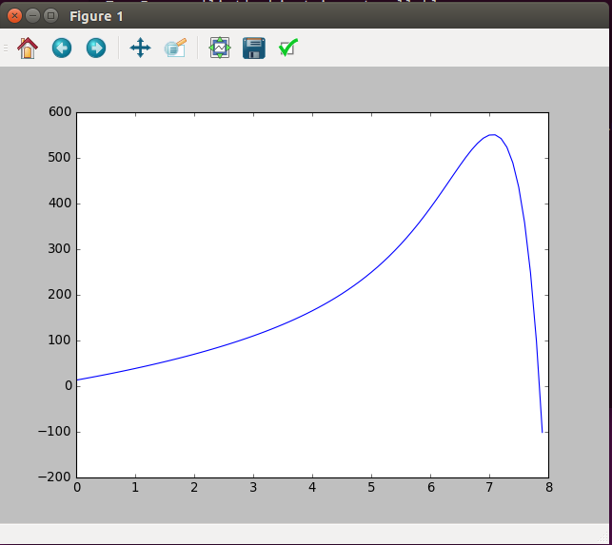
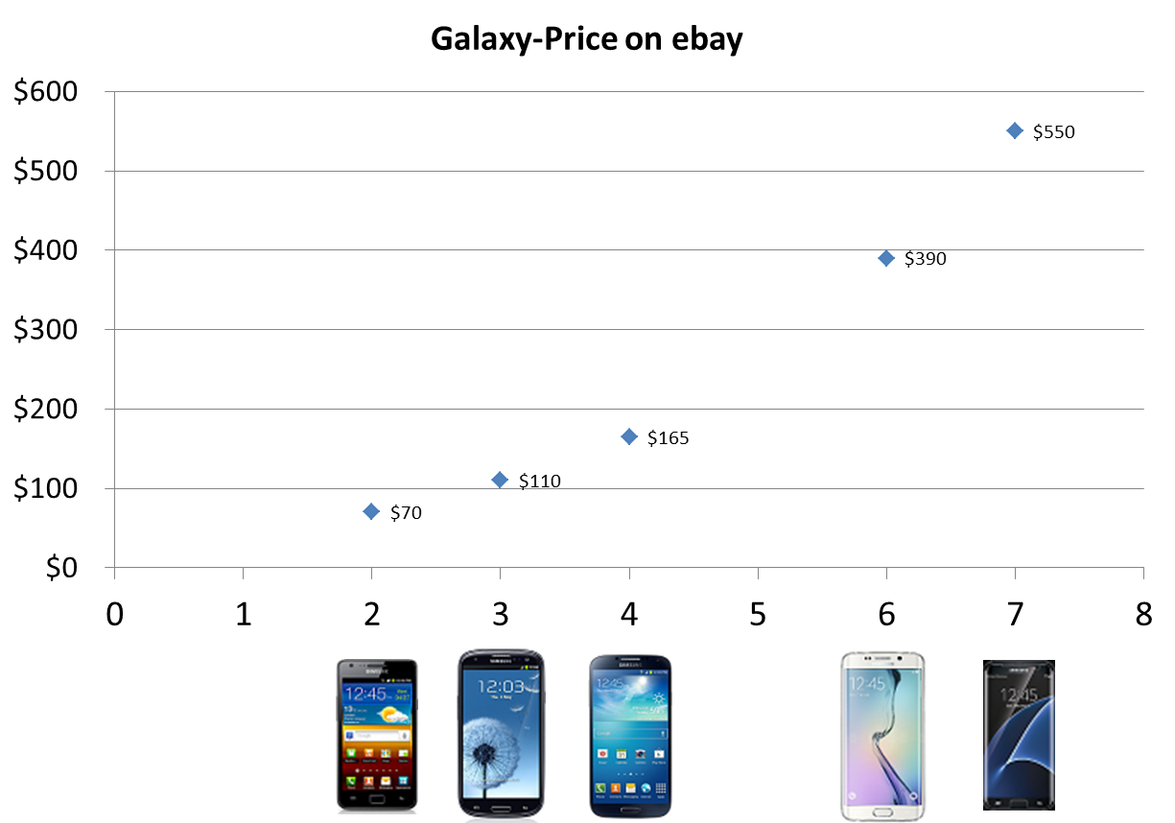
Over-Fitting
Loss = 5.3*10⁻⁷!!!
Bad prediction for 0
Horrible prediction for 8

Slide 19
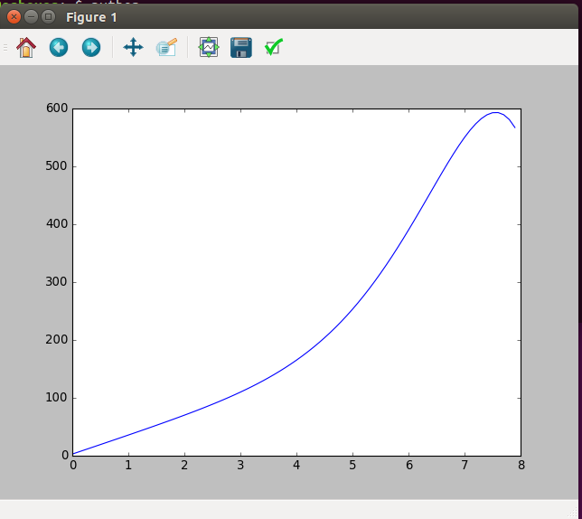
Results with "only" 10 features
Loss = 0.0049

Slide 20
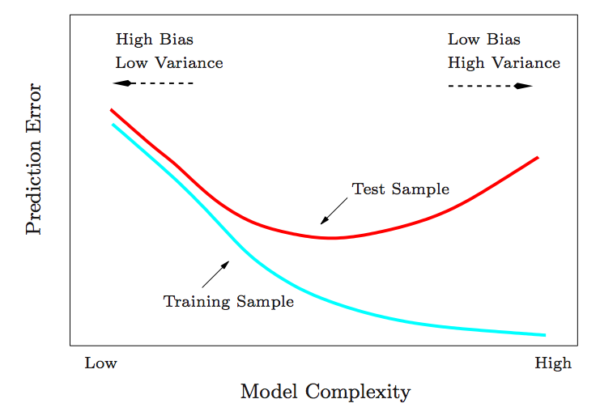
Train/Test error
Credit: Collindcarroll.com

Slide 21
Train-Test-Validation
If we want the test set to be a good prediction to what will happen with new data, it should be used only once.
Therefore, we may want to have a validation set.
The hyper-parameters / model complexity will be determined such that they maximize the accuracy of the validation set.

Slide 22
Regularization
Adding additional terms which penalize the weights.
May reduce variance of complex models.
Examples:
Lasso: λ |W|
Lasso is more aggressive towards smaller weights, so many end-up zero.
Ridge regression: λ|W|²
Many weights may end-up being small, but not zero.
What is the gradient?

Slide 23
20 Features but with Regularization (Ridge)
import tensorflow as tf
import numpy as np
features = 20
suff_feat = range(1,features+1);
np.random.shuffle(suff_feat)
def vecto(x):
ret = []
for i in suff_feat:
ret.append(x**i / 7.**i)
return ret
x = tf.placeholder(tf.float32, [None, features])
y_ = tf.placeholder(tf.float32, [None, 1])
W = tf.Variable(tf.zeros([features,1]))
b = tf.Variable(tf.zeros([1]))
y = tf.matmul(x,W) + b
loss = tf.reduce_mean(tf.pow(y - y_, 2)) + 0.1*tf.nn.l2_loss(W)
update = tf.train.GradientDescentOptimizer(0.1).minimize(loss)
data_x = np.array([vecto(2),vecto(3),vecto(4),vecto(6),vecto(7)])
data_y = np.array([[70],[110],[165],[390],[550]])
sess = tf.Session()
sess.run(tf.initialize_all_variables())
for i in range(0,100000):
sess.run(update, feed_dict = {x:data_x, y_:data_y})
if i % 10000 == 0 :
print('Iteration:' , i , ' W:' , sess.run(W) , ' b:' , sess.run(b), ' loss:', loss.eval(session=sess, feed_dict = {x:data_x, y_:data_y}))
x_axis = np.arange(0, 8, 0.1)
x_data = []
for i in x_axis:
x_data.append(vecto(i))
x_data = np.array(x_data)
y_vals = np.matmul(x_data, sess.run(W)) + sess.run(b)
import matplotlib.pyplot as plt
plt.plot(x_axis, y_vals)
plt.show()
0.1 is the λ-rate
Ridge
tf.nn.l2_loss(W) = tf.reduce_sum(W**2)/2.

Slide 24
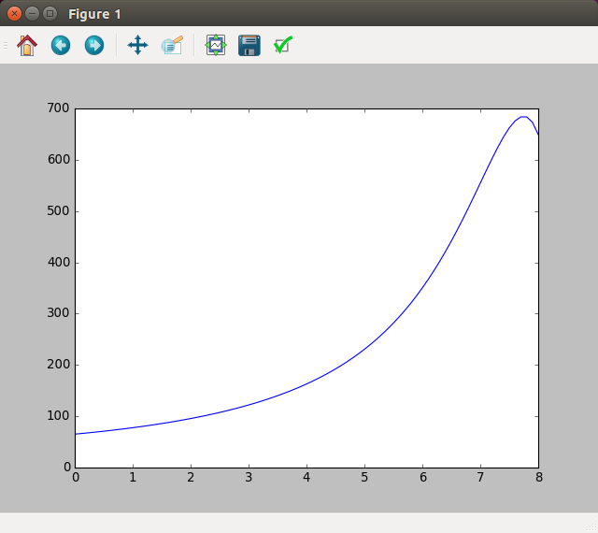
Results (slightly better…)
8 is still not perfect but much better
You can increase/decrease λ and see what happens
0 is much better

Slide 25
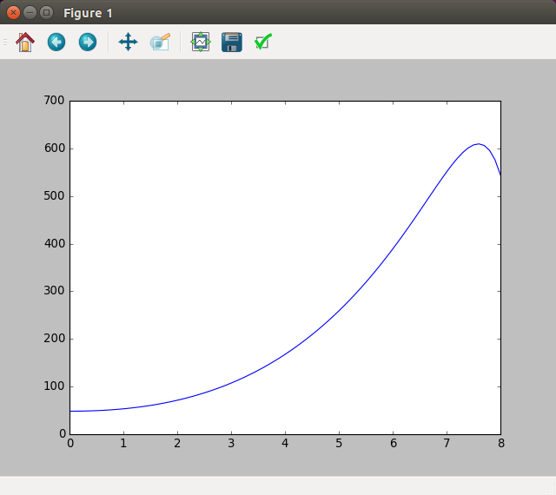
Similar Results with Lasso
import tensorflow as tf
import numpy as np
features = 20
suff_feat = range(1,features+1);
np.random.shuffle(suff_feat)
def vecto(x):
ret = []
for i in suff_feat:
ret.append(x**i / 7.**i)
return ret
x = tf.placeholder(tf.float32, [None, features])
y_ = tf.placeholder(tf.float32, [None, 1])
W = tf.Variable(tf.zeros([features,1]))
b = tf.Variable(tf.zeros([1]))
y = tf.matmul(x,W) + b
loss = tf.reduce_mean(tf.pow(y - y_, 2)) + 0.1*tf.reduce_sum(tf.abs(W))
update = tf.train.GradientDescentOptimizer(0.1).minimize(loss)
data_x = np.array([vecto(2),vecto(3),vecto(4),vecto(6),vecto(7)])
data_y = np.array([[70],[110],[165],[390],[550]])
sess = tf.Session()
sess.run(tf.initialize_all_variables())
for i in range(0,100000):
sess.run(update, feed_dict = {x:data_x, y_:data_y})
if i % 10000 == 0 :
print('Iteration:' , i , ' W:' , sess.run(W) , ' b:' , sess.run(b), ' loss:', loss.eval(session=sess, feed_dict = {x:data_x, y_:data_y}))
x_axis = np.arange(0, 8, 0.1)
x_data = []
for i in x_axis:
x_data.append(vecto(i))
x_data = np.array(x_data)
y_vals = np.matmul(x_data, sess.run(W)) + sess.run(b)
import matplotlib.pyplot as plt
plt.plot(x_axis, y_vals)
plt.show()

Slide 26

Closed form solution
Linear regression has a closed-form solution:
We won't be focusing on it since we will be moving beyond linear regression to problems that do not have closed-form solution.
Furthermore, the closed form solution may be less practical for big data.
We will be using gradient descent (and its variants) until the end of the course.
Notes:
I'm only providing it for soundness
http://www.dsplog.com/2011/12/04/closed-form-solution-linear-regression/
(big data: especially when the X is sparse, but X^T X is dense.)

Slide 27
BGD, SGD, MB-GD
Batch Gradient Descent (BGD): uses all Data-set to compute gradient (this is what we learnt).
May be too large, or take too long:
Stochastic Gradient Descent (SGD): uses only a single example at a time (shuffle data first):
More iterations, since each iteration is less accurate
Mini-Batch Gradient Descent (MB-GD): uses only a subset of the data-set, (e.g. 50) at a time:
A compromise which takes advantage of vectorization.

Slide 28
Classification

Slide 29
Classification
Suppose we wanted to classify phones into new (1) or old/used (0), using the price as a single feature.
Could we use linear regression?
Notes:
What happens if we add additional points to the right or to the left?
What we actually want is the logistic function!

Slide 30
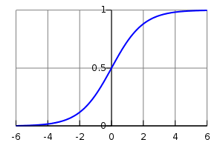
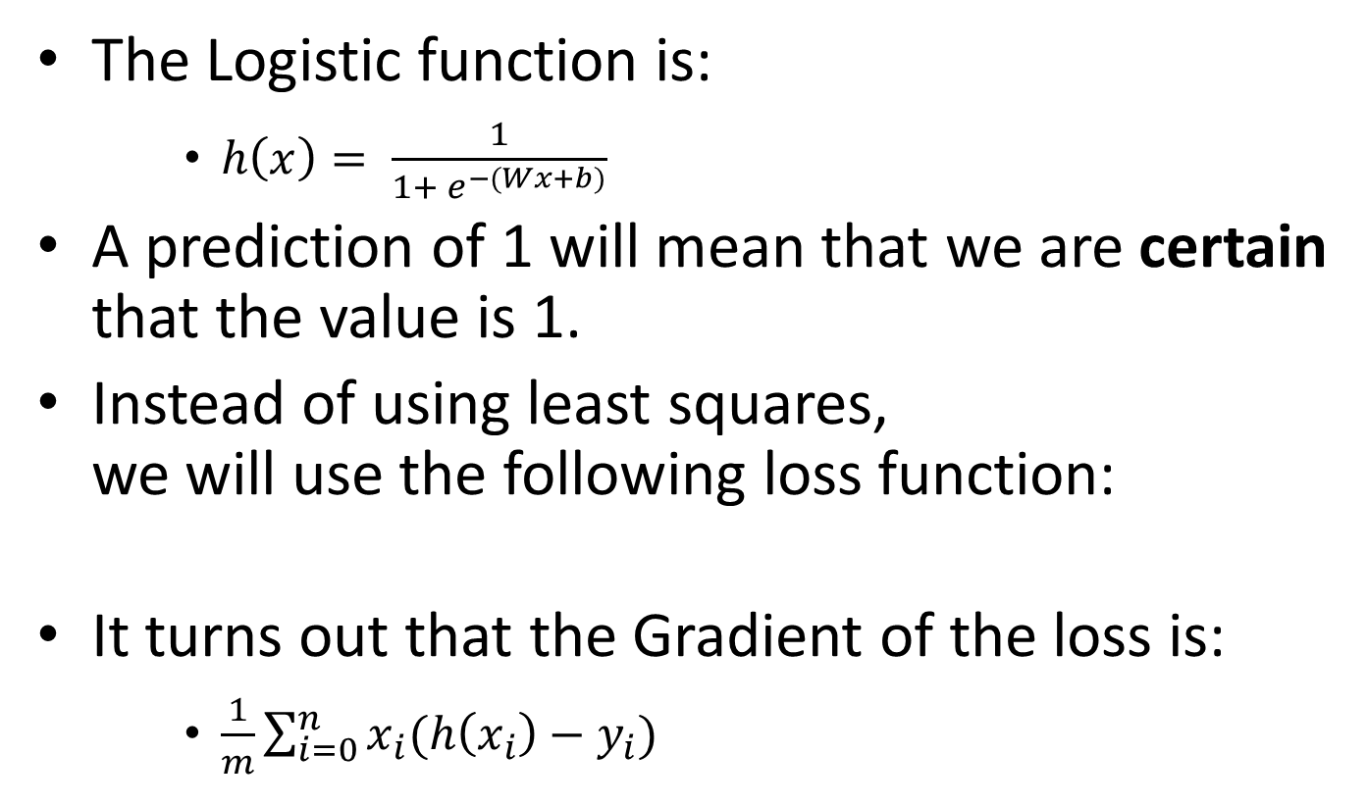
Logistic Regression
The Logistic function is:
$h\left(x\right)= \frac{1}{1+ e^{−(Wx+b)}}$
A prediction of 1 will mean that we are certain that the value is 1.
Instead of using least squares, we will use the following loss function:
It turns out that the Gradient of the loss is:
$\frac{1}{m}\sum_{i=0}^{n}{x_{i}(h\left(x_{i}\right)−y_{i})}$
This is actually the loss function we get when we try to maximize the likelihood of the data
Notes:
Why not use least squares? (we want 1 to present certainty)
The W controls the steepness and the b controls the bias
h(xi) is different

Slide 31
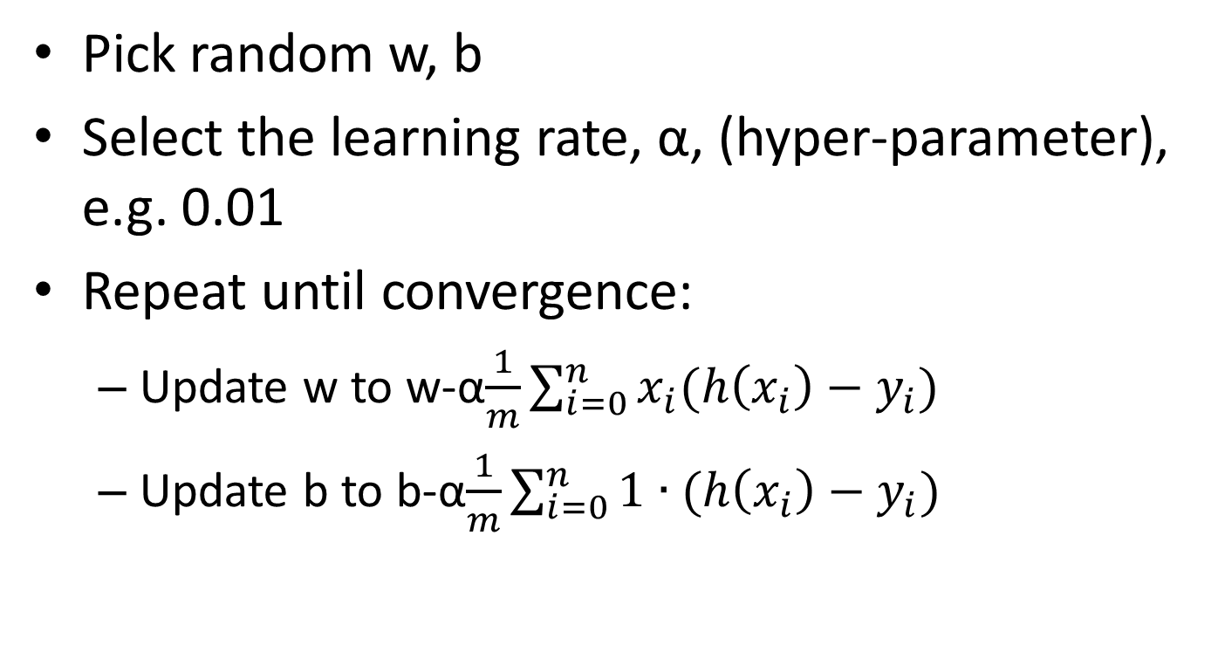
Gradient Descent in Logistic Regression
Pick random w, b
Select the learning rate, α, (hyper-parameter), e.g. 0.01
Repeat until convergence:
Update w to w-α$\frac{1}{m}\sum_{i=0}^{n}{x_{i}(h\left(x_{i}\right)−y_{i})}$
Update b to b-α$\frac{1}{m}\sum_{i=0}^{n}{\text{1}∙(h\left(x_{i}\right)−y_{i})}$

Slide 32
How-come?
Does the previous slide look familiar?
The previous slide is identical to the slide we have seen in linear regression (I actually did a copy-paste and only changed the title).
So how is logistic regression actually different than linear regression? If it is exactly the same algorithm, why not use linear regression?
Obviously, the algorithms are different because the hypothesis (h(x)) is totally different…

Slide 33
Employed or not?
We have a data-base with all our users and we want to send out job-offers.
For that, we need to know all unemployed users, though we only know this information on a fraction of the data.
We would like to build a classifier that determines whether a user is employed or not, based on the user's age, gender and years of experience.

Slide 34
Our dataset
This is fake data, sorry about any gender/age biases introduced intentionally…
Employed users:
Female, 28 years old, 4 years of experience
Female, 60 years old, 34 years of experience
Female, 25 years old, 3 year of experience
Male, 54 years old, 20 years of experience
Male, 24 years old, 2 years of experience
Male, 39 years old, 12 years of experience
Male, 30 years old, 4 years of experience
Unemployed users:
Female, 36 years old 10 years of experience
Female, 26 years old 1 year of experience
Male, 44 years old, 9 years of experience
Do you think that a female, 49 year old with 8 years of experience employed?
What about a male, 29 years old with 3 years of experience?
And if it were a female?

Slide 35
import numpy as np
data_x = np.array([[1,28,4],[1,60,34],[1,25,3],[0,54,20],[0,24,2],[0,39,12],[0,30,4],[1,36,10],[1,26,1],[0,44,9]])
data_y = np.array([1,1,1,1,1,1,1,0,0,0])
def h(x,w,b):
return 1 / (1+np.exp(-(np.dot(x,w) + b)))
w = np.array([0.,0,0])
b = 0
alpha = 0.001
for iteration in range(100000):
deriv_b = np.mean(1*( (h(data_x,w,b)- data_y)))
deriv_w = np.dot((h(data_x,w,b) - data_y), data_x)*1/len(data_y)
b -= alpha*deriv_b
w -= alpha*deriv_w
print("User [1, 49, 8] prob of working: ", h(np.array([[1, 49, 8]]),w,b))
print("User [0, 29, 3] prob of working: ", h(np.array([[0, 29, 3]]),w,b))
print("User [1, 29, 3] prob of working: ", h(np.array([[1, 29, 3]]),w,b))

Slide 36
Results
User [1, 49, 8] prob of working: [ 0.21107079]
User [0, 29, 3] prob of working: [ 0.66430518]
User [1, 29, 3] prob of working: [ 0.43735087]

Slide 37
Classification (Text Example)
Classifying a text message to urgent/non-urgent, based on its words (so the phone will know if to play a notification sound).
E.g.:
“Where are you? I’m trying to reach you for half an hour already, contact me ASAP I need to leave now!”
“I want to go out for lunch, let me know in the next couple of minutes if you would like to join.”
“I was wondering whether you are planning to attend the party we are having next month.”
Any Ideas?
Using logistic regression?

Slide 38
Bag-of-Words Model (like we did while using in Naïve Bayes)
x1 = {0, 0, 0, 0, …., 0, 1, 0, …., 0, 1, 0,…,…,1,…}
aardvark … already … are … … you…
“you” can either get 1 or 3 depending on the selected model.
Instead of using all words, can use only words which appear in the training set or the X most common words while marking the rest as UNK.
Notes:
There can also be a model which records both 1 and 3, or 1, 2, greater than 2, etc.

Slide 39
Logistic Regression (Preprocessing: Preparing Data)
vocabulary_size = 0 #can use "global" keyword
word2location = {}
def prepare_vocabulary(data):
idx = 0
for sentence in data:
for word in sentence.split(): # better use nltk.word_tokenize(sentence) and perform some stemming etc.!!!
if word not in word2location:
word2location[word] = idx
idx += 1
return idx
def convert2vec(sentence):
res_vec = np.zeros(vocabulary_size)
for word in sentence.split(): #also here...
if word in word2location:
res_vec[word2location[word]] += 1
return res_vec

Slide 40
Logistic Regression (Preprocessing cont.)
data = ["Where are you? I'm trying to reach you for half an hour already, contact me ASAP I need to leave now!", "I want to go out for lunch, let me know in the next couple of minutes if you would like to join.", "I was wondering whether you are planning to attend the party we are having next month.", "I wanted to share my thoughts with you."]
vocabulary_size = prepare_vocabulary(data)

Slide 41
Logistic Regression (Preprocessing Examples)
>>> print(convert2vec(data[1])) # "I want to go out for lunch, let me know in the next couple of minutes if you would like to join."
[ 0. 0. 0. 0. 0. 2. 0. 1. 1. 0. 0. 0. 0. 0. 1. 0. 1. 0.
0. 0. 1. 1. 1. 1. 1. 1. 1. 1. 1. 1. 1. 1. 1. 1. 1. 1.
0. 0. 0. 0. 0. 0. 0. 0. 0. 0. 0. 0. 0. 0. 0.]
>>> print(convert2vec(data[0])) # "Where are you? I’m trying to reach you for half an hour already, contact me ASAP I need to leave now!"
[ 1. 1. 1. 1. 1. 2. 1. 1. 1. 1. 1. 1. 1. 1. 1. 1. 1. 1.
1. 1. 0. 0. 0. 0. 0. 0. 0. 0. 0. 0. 0. 0. 0. 0. 0. 0.
0. 0. 0. 0. 0. 0. 0. 0. 0. 0. 0. 0. 0. 0. 0.]

Slide 42
Logistic Regression in TensorFlow (Cont.)
features = vocabulary_size
x = tf.placeholder(tf.float32, [None, features])
y_ = tf.placeholder(tf.float32, [None, 1])
W = tf.Variable(tf.zeros([features,1]))
b = tf.Variable(tf.zeros([1]))
y = 1 / (1.0 + tf.exp(-(tf.matmul(x,W) + b)))
loss = tf.reduce_mean(tf.pow(y - y_, 2))
update = tf.train.GradientDescentOptimizer(0.00001).minimize(loss)
data_x = np.array([convert2vec(data[0]), convert2vec(data[1]), convert2vec(data[2]), convert2vec(data[3])])
data_y = np.array([[1],[1],[0],[0]])
sess = tf.Session()
sess.run(tf.initialize_all_variables())
for i in range(0,10000):
sess.run(update, feed_dict = {x:data_x, y_:data_y}) #BGD
Notes:
Obviously, the input data should be given in a nicer way. E.g. [convert2vec(data[i]) for i in range(len(data))]
You can recheck the differences at home.

Slide 43
Logistic Regression Results
def logistic_fun(z):
return 1/(1.0 + np.exp(-z))
test1 = "I need you now! Please answer ASAP!"
test2 = "I wanted to hear your thoughts about my plans."
#pdb.set_trace()
print('Prediction for: "' + test1 + '"', logistic_fun(np.matmul(np.array([convert2vec(test1)]),sess.run(W)) + sess.run(b))[0][0])
print('Prediction for: "' + test2 + '"', logistic_fun(np.matmul(np.array([convert2vec(test2)]),sess.run(W)) + sess.run(b))[0][0])
('Prediction for: "I need you now! Please answer ASAP!"', 0.5043)
('Prediction for: "I wanted to hear your thoughts about my plans."', 0.4981)
Notes:
If we don't use [0][0], we will get [[0.5043]] instead of 0.5043.

Slide 44
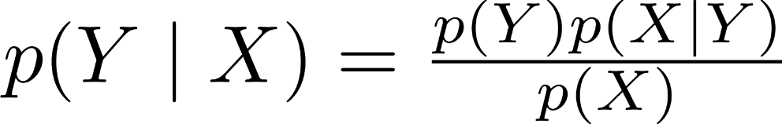
Meaning of Logistic Regression Result
The result given by logistic regression is suppose to relate to the probability of the instance belonging to the class p(y=1 | X).
Logistic regression is a discriminative model, that is, it tries to model p(y | X) directly.
Recall that in the naïve Bayes classifier (which is a generative model), we used the Bayes rule, and therefore had to model:
p(y) and p(X | y) (and p(X))

Slide 45
Normalization
Sometimes it may be useful to normalize all the data around [0,0,0,…,0] with some standard deviation (1).
Batch-normalization: normalize all data in the given (mini) batch.

Slide 46
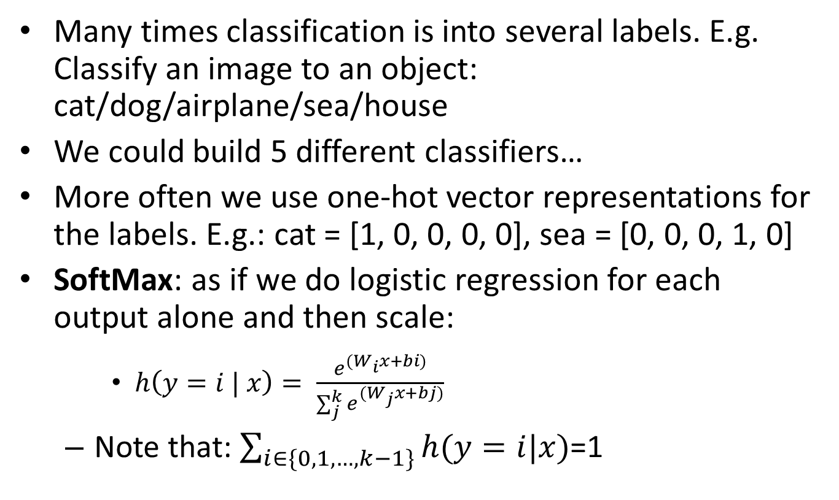
Multiple Classes
Many times classification is into several labels. E.g. Classify an image to an object: cat/dog/airplane/sea/house
We could build 5 different classifiers…
More often we use one-hot vector representations for the labels. E.g.: cat = [1, 0, 0, 0, 0], sea = [0, 0, 0, 1, 0]
SoftMax: as if we do logistic regression for each output alone and then scale:
$h\left(y=i | x\right)= \frac{e^{(W_{i}x+bi)}}{\sum_{j}^{k}{e^{(W_{j}x+bj)}}}$
Note that: $\sum_{i∈\{0,1,…,k−1\}}{h(y=i|x)}$=1

Slide 47
Average Cross Entropy Loss Function
loss = -np.mean(y*np.log(h(x)))
Prediction (SoftMax) | Actual | Log(pred.) | Cross Entropy
[0.4, 0.5, 0.1] | [1, 0, 0] | [-0.92, -0.69, -2.3]
[0.2, 0.7, 0.1] | [0, 1, 0] | [-1.61, -0.36, -2.3]
[0.1, 0.2, 0.6] | [0, 0, 1] | [-2.3, -1.61, -0.51]
-0.92
-0.36
-0.51
Loss = 0.597

Slide 48
Visualization (Logistic Regression)
1st Feature
w₁
2nd Feature
b
sigmoid
w₂
output
0.82
w₃
3rd Feature
w₄
4th Feature
An output of 0.82 means that this classifier believe that there is a 82% chance that this instance is positive.
Therefore, this instance is classified as positive.

Slide 49
Visualization (SoftMax)
w₁₁
b₁
1st Feature
Class1
XW+b
Softmax
0.30
w₂₁
w₁₂
2nd Feature
w₁₃
b₂
w₂₂
Class2
XW+b
0.49
w₁₄
w₂₃
3rd Feature
w₃₁
b₃
w₃₂
Class3
w₂₄
w₃₃
XW+b
0.21
4th Feature
w₃₄
The result is a vector: [0.3, 0.49, 0.21],
which should be interpreted as probabilities
Therefore, this instance was classified as Class2

Slide 50
SMS Classification
We would like to classify a text message into one of the following:
Finance
Work
Family & Friends
We will be using the same bag-of-words model.

Slide 51
Implementation in TensorFlow
data = [
"Your auto payment of $50 was charges successfully!",
"You have received a refund of $20",
"Please complete your power point presentation by tomorrow.",
"You must arrive on time tomorrow, otherwise the manager will want to talk to you",
"How about celebrating Bob's birthday party next week?",
"Everyone is waiting for you at home, please come home early!"]

Slide 52
Softmax in TensorFlow (cont.)
…
categories = 3
x = tf.placeholder(tf.float32, [None, features])
y_ = tf.placeholder(tf.float32, [None, categories])
W = tf.Variable(tf.zeros([features,categories]))
b = tf.Variable(tf.zeros([categories]))
y = tf.nn.softmax(tf.matmul(x, W) + b)
loss = -tf.reduce_mean(y_*tf.log(y))
update = tf.train.GradientDescentOptimizer(0.00001).minimize(loss)
data_x = np.array([convert2vec(data[i]) for i in range(len(data))])
data_y = np.array([[1,0,0],[1,0,0],[0,1,0],[0,1,0],[0,0,1],[0,0,1]])
…
Both x and y_ are now matrixes
W is now a matrix
Note the use of SoftMax
And b is a vector
Average cross entropy loss
One-hot vector encoding
Here we do all the training etc. just as before

Slide 53
Results
print('Prediction for: "' + test[i] + ': "', sess.run(y, feed_dict={x:[convert2vec(test[i])]}))
('Prediction for: "Your payment has been received, no refund is currently available.: "', array([[ 0.37513995, 0.31168658, 0.31317347]], dtype=float32))
('Prediction for: "The manager said that your presentation went well, but next time make sure to arrive on time.: "', array([[ 0.22385776, 0.51536894, 0.2607733 ]], dtype=float32))
('Prediction for: "We are all waiting for you at the birthday party!: "', array([[ 0.27309075, 0.28819606, 0.43871319]], dtype=float32))

